Slide 1
Chapter 12
Levels of Testing

Slide 2
Levels and Life Cycle Models
Levels of testing depend primarily on the software life cycle used.
BUT, most forms of testing levels are derived from the V-Model version of the good, old Waterfall Model.
Iterative models introduce the need for regression testing.
System testing is greatly enhanced when an executable specification is used.

Slide 3
Software Development Life Cycle Models
Waterfall (presumes perfect foresight)
Incremental (delayed prototypes)
Rapid Prototyping (elicit user feedback)
Operational Specification (executable)
Transformational Implementation (lab only)
Agile Methods
Increasingly Operational views
Ref. Agresti, New Paradigms of Software Development IEEE Tutorial

Slide 4
Requirements Speciﬁcation
The Waterfall Model
Preliminary Design
Detailed Design
Coding
Unit Testing
Output of a phase is the input to the next phase
Integration Testing
System Testing

Slide 5
The Waterfall Model (continued)
Requirements Specification
what
Preliminary Design
what
how
Detailed Design
what
how
how
Coding
Unit Testing
Integration Testing
Feedback Cycles
System Testing

Slide 6
The Waterfall Model (aka the V-Model)
Levels of Abstraction and Testing
Requirements Specification
System Testing
Preliminary Design
Integration Testing
Detailed Design
Unit Testing
Coding

Slide 7
The Waterfall Model: Advantages
Framework fits well with
levels of abstraction
levels of management
programming language packaging
Phases have clearly defined end products
Convenient for project management
Works well with Functional Decomposition
Massive parallel development

Slide 8
The Waterfall Model: Disadvantages
Long customer feedback cycle resolving faults found during system testing is extremely expensive
"Exists for the convenience of management"
(-- M. Jackson) stifles creativity and unnecessarily constraints designer's thought processes
Stresses analysis to the exclusion of synthesis
High peak in manpower loading profile
"Requires perfect foresight" -- William Agresti
any errors, omissions in early phases will propagate

Slide 9
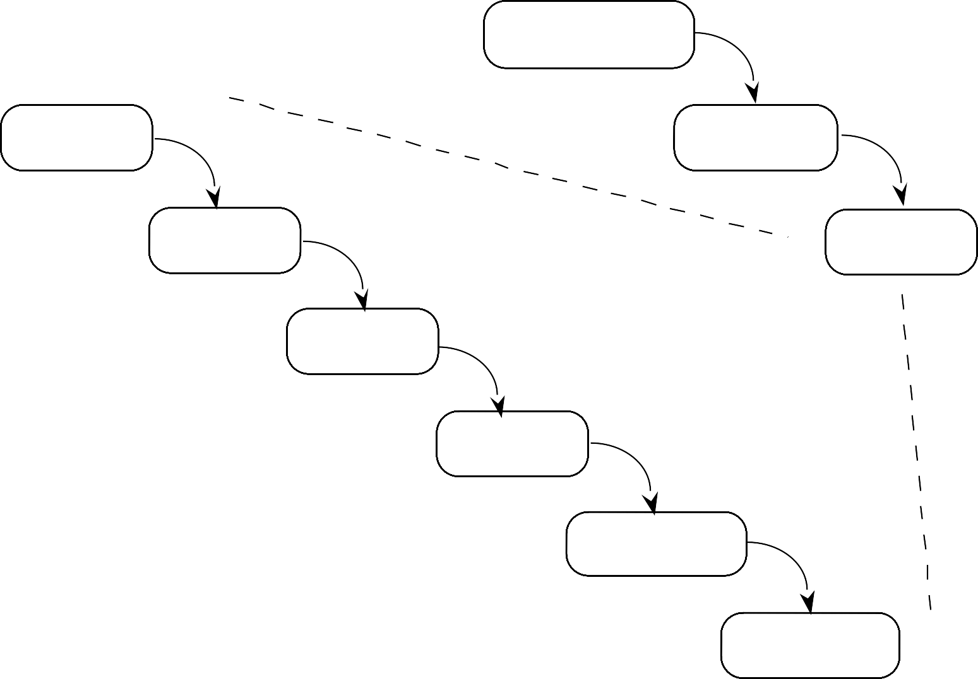
Incremental Software Development
Requirements Specification
Detailed Design
Preliminary Design
Coding
Series of Builds
Unit Testing
Integration Testing
Regression Testing
Progression Testing

Slide 10
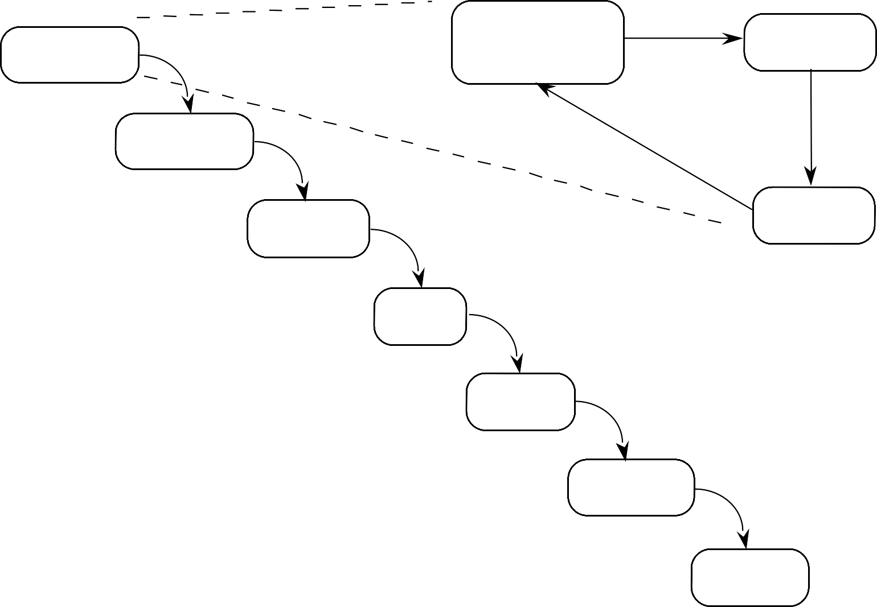
Rapid Prototyping Software Development
Define Prototype Objectives
Build Prototype
Series of Prototypes
Preliminary Design
Detailed Design
Customer Feedback
Coding
Unit Testing
Integration Testing
System Testing

Slide 11
Rapid Prototyping
Why prototype?
To determine feasibility
To obtain early customer feedback Keep or dispose?
To be rapid, many compromises are made. If a prototype is kept, it will be extremely difficult to modify and maintain.
Best practice: dispose once purpose has been served.

Slide 12
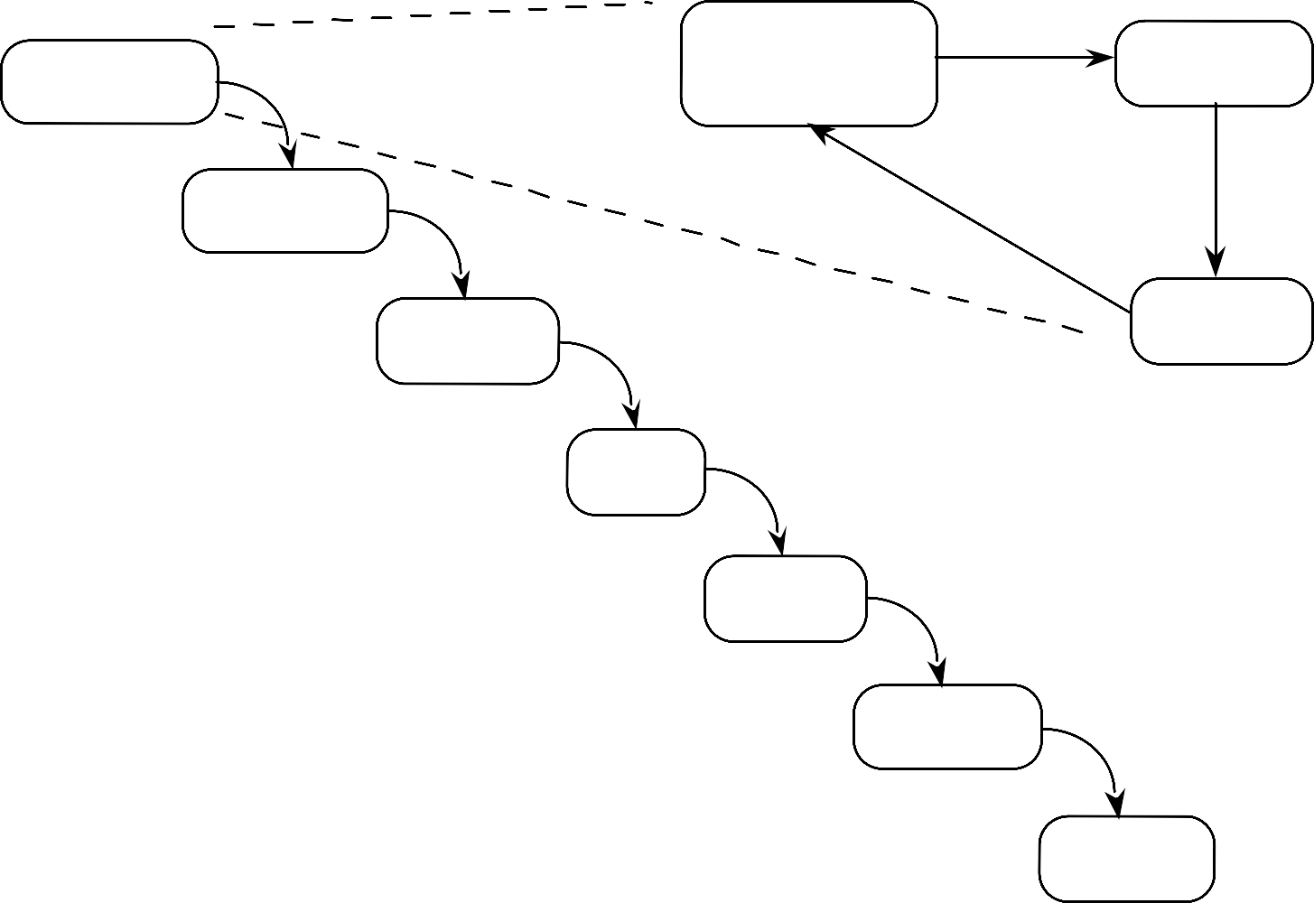
Software Development with an Executable Specification
Develop executable specification
execute spec
Requirements Specification
Preliminary Design
Detailed Design
Customer Feedback
Coding
Unit Testing
Integration Testing
System Testing

Slide 13
Executable Specifications
Why use an executable specification?
To determine behavior
To obtain early customer feedback Other uses?
Automatic generation of system test cases.
Develop order of test case execution
Training
Early analysis

Slide 14
Transformational Implementation
Formal Requirements Specification
Series of Transformations
Working System
Customer Testing
Requirements Specification
System Testing

Slide 15
Transformational Specification Pros and Cons
Advantages:
Intermediate Waterfall phases (design, code, test) are eliminated.
Customer tests delivered system
All maintenance is done on specification
Disadvantages:
Specification must be very formal (predicate calculus)
Series of transformations is not well understood; tends to be specific to application domains
Very limited success so far.
Doesn't scale up well.
Knowing what to change in the formal specification is difficult

Slide 16
Agile Methods
Many flavors
eXtreme Programming (XP)
SCRUM
Test-Driven Development
Customer-Driven
Goals
Respond to customer
Reduce unnecessary effort
Always have something that works

Slide 17
Length of Feedback Cycle (Customer/Developer)
Where would you put the other life cycle models?
Waterfall
Agile

Slide 18
Hybrid Models
Because they replace the Requirements specification phase, rapid prototyping and executable specifications can be merged with the iterative models.
The Agile Models are highly iterative, but they typically are not used in combination with rapid prototyping or executable specifications.

